Slide 1
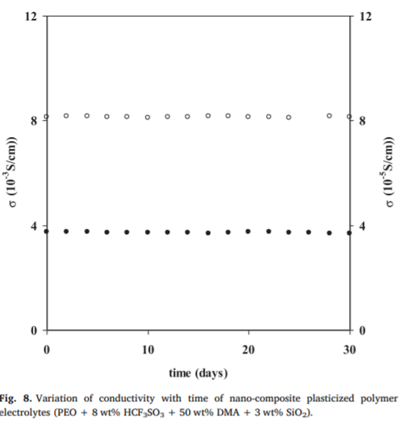
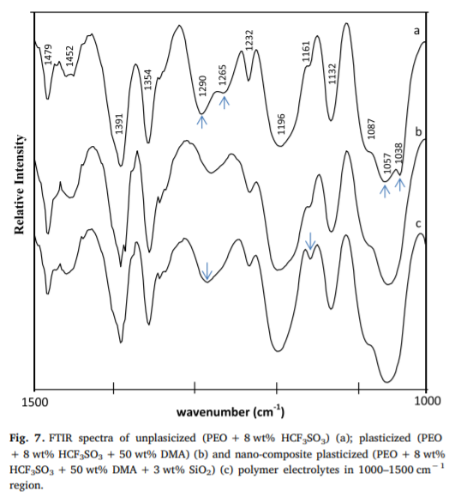
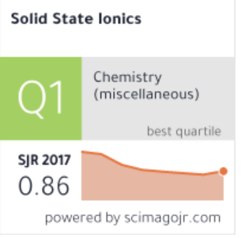
Scope of the study FTIR studies was carried out to check the formation of ion aggregates at higher acid concentration and its dissociation with the addition of plasticizer, which leads to increase in conductivity Samples Polymer electrolytes have been prepared by solution casting method in which acid and polymer were dissolved in acetonitrile and stirred continuously until a homogeneous solution was obtained. Process and Findings FTIR spectra of the samples were recorded by Perkin Elmer FTIR spectrometer at room temperature. No improving on mechanical properties of material was achieved. FTIR results indicated that ion aggregates are present in unplasticized polymer electrolytes at high acid concentrations (8 wt %) along with the presence of free ions The increase in conductivity with the addition of plasticizer was explained due to dissociation of ion aggregates, which was supported by FTIR studies Application The small change in conductivity over 30–130 °C temperature range suggests that these electrolytes are suitable for their use in device applications like fuel cells, supercapacitors, sensors, separators and other electrochromic devices
Ionic conductivity, FTIR and thermal studies of nano-composite plasticized proton conducting polymer electrolytes
*All the images and information have been taken from the original paper for scholar purposes.

